Slide 1
OpenCV 3.0 Modules
Cool stuff you might not have known about
Vadim Pisarevsky
Principal Engineer, Itseez

Slide 2
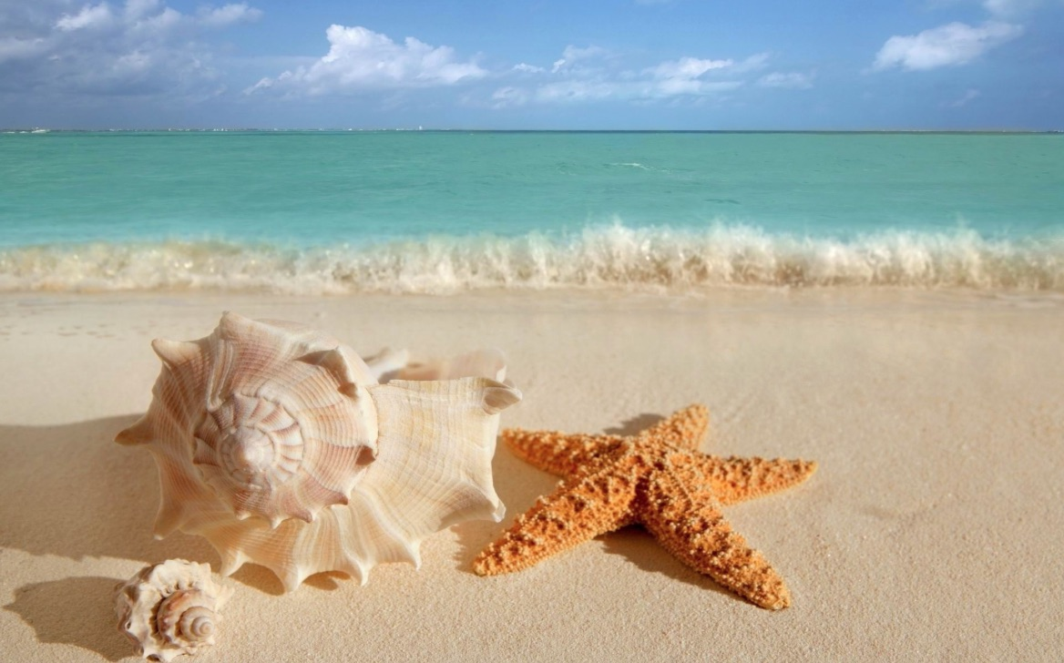
Introduction
Doing OpenCV is like sitting near the ocean and collecting shells as they get to the coast
In OpenCV there are 1000’s of them, I will show you 9

Slide 3
0a. The easiest way to start with OpenCV
clone http://github.com/itseez/opencv & opencv_contrib
build it; do not install it!
use the following CMake file for you sample
cmake_minimum_required(VERSION 2.8)
project(myopencv_sample)
find_package(OpenCV REQUIRED)
include_directories(${OpenCV_INCLUDE_DIRS})
set(the_target "myopencv_sample")
add_executable(${the_target} main.cpp) # add other .cpp
# and .h files here
target_link_libraries(${the_target} ${OpenCV_LIBS})
locate OpenCVConfig.cmake when cmake complains
you are good to go!

Slide 4
0b. The easiest way to start with OpenCV
typical OpenCV sample template
#include “opencv2/opencv.hpp” // joint “main” opencv header
// include opencv_contrib, hal etc. headers separately …
// make code wrist- and eyes-friendly
// … or put your code into cv[::nested_namespace] namespace
using namespace cv;
using namespace std;
// for most experiments you do not need full-scale GUI app.
// just do the things and display results with highgui
int main(int argc, char** argv) {
// dst is created automatically
Mat src = imread(argv[1]), dst;
…
imshow(“test”, src); // no need in namedWindows()
waitKey(); // do not forget it
return 0; // skip cleanup things
}

Slide 5
1. core
There are Downhill Simplex (DownhillSolver), Conjugate Gradient (ConjGradSolver) and linear programming (solveLP) solvers in 3.0
class Rosenbrock : public MinProblemSolver::Function {
int getDims() const { return 2; }
double calc(const double* x)const {
return 100*(x[1]-x[0]*x[0])*(x[1]-x[0]*x[0])+(1-x[0])*(1-x[0]);
}
// override calcGradient() if you want to compute it analytically
};
Ptr<ConjGradSolver> solver = makePtr<ConjGradSolver>();
solver->setFunction(Rosenbrock);
Mat x = (Mat_<double>(2,1) << 0.0, 0.0);
double fval = solver->minimize(x);

Slide 6
2. imgproc
Fast connected component extraction – much faster than findContours + drawContours.
Mat bw_image;
…
Mat_<int> labels, stats;
int ncomps = connectedComponentsWithStats(bw_image, labels, stats, noArray());
for( int i = 0; i < ncomps; i++ ) {
Rect roi(stats(i,0), stats(i,1), stats(i,2), stats(i,3));
int area = stats(i,4);
// process i-th connected component
}

Slide 7
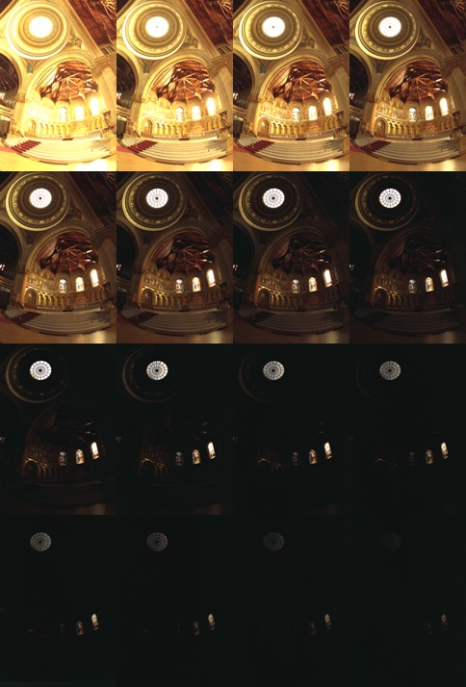
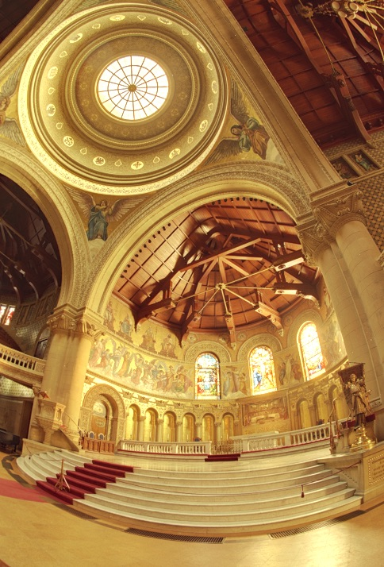
3. photo
do HDR in a few lines of code
vector<Mat> exposures;
for( int i = 0; i < n; i++ )
exposures.push_back(imread(format(“image%02d.jpg”, i)));
Mat fusion;
Ptr<MergeMertens> merge_mertens = createMergeMertens();
merge_mertens->process(exposures, fusion);

Slide 8


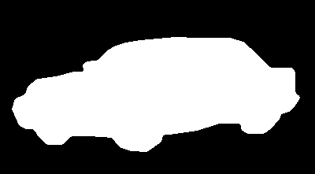
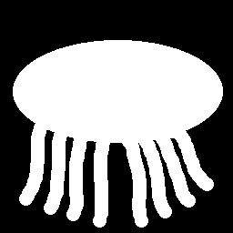



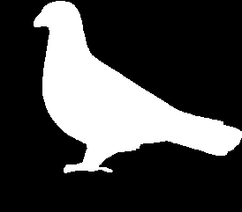



4. shape
Shape Context and other ways to match shapes
Mat bw_img[2]; vector<Point> shape[2]; vector<vector<Point> > cs;
RNG& rng = theRNG();
for( int k = 0; k < 2; k++ ) {
// find contour of each shape
findContours(bw_img[k], cs, RETR_LIST, CHAIN_APPROX_NONE);
int npoints = (int)cs[0].size(), npoints0 = 300;
// assuming that the shape has a single contour, sample 300 random points of it
for (int i = 0; i < npoints0; i++ )
shape[k].push_back(cs[0][rng.uniform(0, npoints)]);
}
// create shape context object and compute the distance between shapes
Ptr <ShapeContextDistanceExtractor> sc = createShapeContextDistanceExtractor();
float dis = sc->computeDistance( shape[0], shape[1] );
~157
~0.5

Slide 9
5. calib3d
Try RHO algorithm for homography estimation (several times faster than RANSAC)
Mat img[2], desc[2]; vector<KeyPoint> kpt[2];
Ptr<ORB> f2d = ORB::create();
for( int k = 0; k < 2; k++ ) {
img[k] = imread(format(“image%d.png”, k+1), 0);
f2d->detectAndCompute( img[k], Mat(), kpt[k], desc[k], false );
}
vector< DMatch > matches;
BFMatcher(NORM_HAMMING,true).match( desc[0], desc[1], matches );
vector<Point2f> points[2];
for( size_t i = 0; i < matches.size(); i++ ) {
points[0].push_back(kpt[matches[i].queryIdx].pt);
points[1].push_back(kpt[matches[i].trainIdx].pt);
}
Mat H, inliers;
H = findHomography( points[0], points[1], RHO, 1.0, inliers );

Slide 10
6. features 2d
KAZE/AKAZE features are state-of-art in terms of robustness and localization accuracy.
Mat img[2], desc[2]; vector<KeyPoint> kpt[2];
Ptr<AKAZE> f2d = AKAZE::create();
for( int k = 0; k < 2; k++ ) {
img[k] = imread(format(“image%d.png”, k+1), 0);
f2d->detectAndCompute( img[k], Mat(), kpt[k], desc[k], false );
}
vector< DMatch > matches;
BFMatcher(NORM_HAMMING,true).match( desc[0], desc[1], matches );
vector<Point2f> points[2];
for( size_t i = 0; i < matches.size(); i++ ) {
points[0].push_back(kpt[matches[i].queryIdx].pt);
points[1].push_back(kpt[matches[i].trainIdx].pt);
}
Mat H, inliers;
H = findHomography( points[0], points[1], RHO, 1.0, inliers );
Inliers: ORB – 208/446 (47%) , AKAZE – 28/36 (78%)

Slide 11
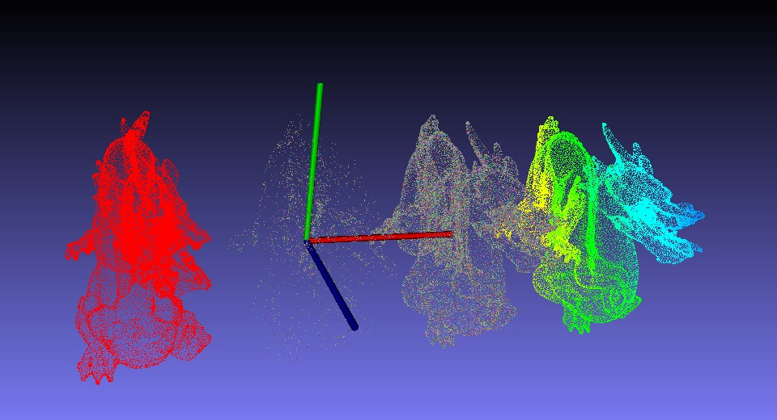
7. viz, Affine3D
VTK-based tool for convenient 3D visualization
http://habrahabr.ru/company/itseez/blog/217021/ - tutorial (in Russian)
Mat cloud = viz::readCloud(“dragon.ply”); // read point cloud
Mat colors(cloud.size(), CV_8UC3); randu(colors, 50, 255); // gen color for each point
// make “sparse” (1/16) version of the cloud
float qnan = std::numeric_limits<float>::quiet_NaN();
Mat masked_cloud = cloud.clone();
for(int i = 0; i < cloud.total(); ++i)
if(i%16 != 0) masked_cloud.at<Vec3f>(i)= Vec3f(qnan, qnan, qnan);
Viz3d viz(“dragons”); // make 3d view (like named window)
viz.showWidget(“coo”, WCoordinateSystem()); // display coordinate axes
viz.showWidget(“red”, WCloud(cloud, Color::red()), // 1. red dragon
Affine3d().translate(Vec3d(-1.0, 0.0, 0.0)));
viz.showWidget(“colored”, WCloud(cloud, colors), // 2. randomly-colored dragon
Affine3d().translate(Vec3d(+1.0, 0.0, 0.0)));
viz.showWidget(“masked”, // 3. melting dragon
WCloud(masked_cloud, colors), Affine3d::Identity());
viz.showWidget(“painted”, WPaintedCloud(cloud), // 4. rainbow gradon
Affine3d().translate(Vec3d(+2.0, 0.0, 0.0)));
viz.spin(); // run the event loop, user can rotate, zoom in/out etc. the view

Slide 12
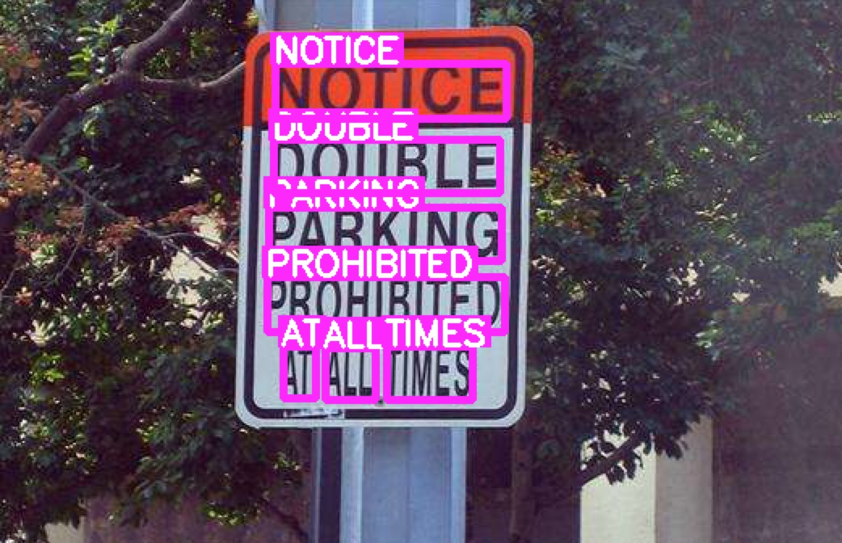
8. text
Text detection using Matas & Neumann algorithm, “letter” grouping, recognition (use of Tesseract)
// form channels
Mat image = imread(…), gray, group_img; vector<Mat> channels;
cvtColor(image, gray, COLOR_BGR2GRAY);
channels.push_back(gray); channels.push_back(255-gray);
// create and apply ER filters, or you can also use MSER
Ptr<ERFilter> er_filter1 = createERFilterNM1(loadClassifierNM1(
"trained_classifierNM1.xml"),8,0.00015f,0.13f,0.2f,true,0.1f);
Ptr<ERFilter> er_filter2 = createERFilterNM2(loadClassifierNM2(
"trained_classifierNM2.xml"),0.5); // create filters out of the loop!
vector<vector<ERStat> > regions(channels.size());
for( size_t c = 0; c < channels.size(); c++ ) {
er_filter1->run(channels[c], regions[c]);
er_filter2->run(channels[c], regions[c]);
}
// group regions
vector< vector<Vec2i> > nm_region_groups;
vector<Rect> nm_boxes;
erGrouping(image, channels, regions, nm_region_groups,
nm_boxes,ERGROUPING_ORIENTATION_HORIZ);
// recognize the text
Ptr<OCRTesseract> ocr = OCRTesseract::create();
vector<string> words;
for (size_t i=0; i < nm_boxes.size(); i++) {
group_img(nm_boxes[i]).copyTo(group_img);
copyMakeBorder(group_img, group_img, 15,15,15,15,BORDER_CONSTANT,Scalar(0));
string ocr_out; ocr->run(group_img, ocr_out); words.push_back(ocr_out); }

Slide 13
9a. bioinspired
Retina model for image/video preprocessing
From the excellent tutorial: http://docs.opencv.org/doc/tutorials/contrib/retina_model/retina_model.html:
The retina model presents two outputs:
The first one is called the Parvocellular channel. It is mainly active in the foveal retina area (high resolution central vision with color sensitive photo-receptors), its aim is to provide accurate color vision for visual details remaining static on the retina. On the other hand objects moving on the retina projection are blurred.
The second well known channel is the Magnocellular channel. It is mainly active in the retina peripheral vision and send signals related to change events (motion, transient events, etc.). These outing signals also help visual system to focus/center retina on ‘transient’/moving areas for more detailed analysis thus improving visual scene context and object classification.

Slide 14
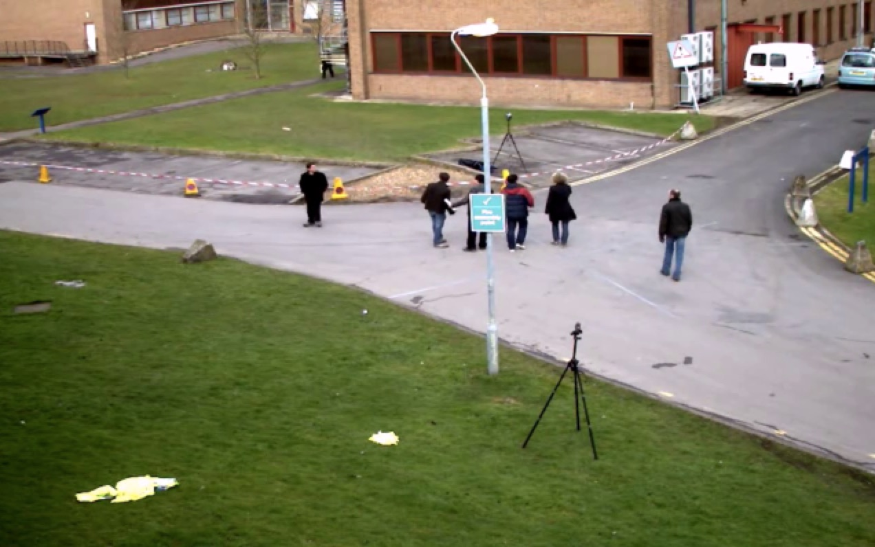
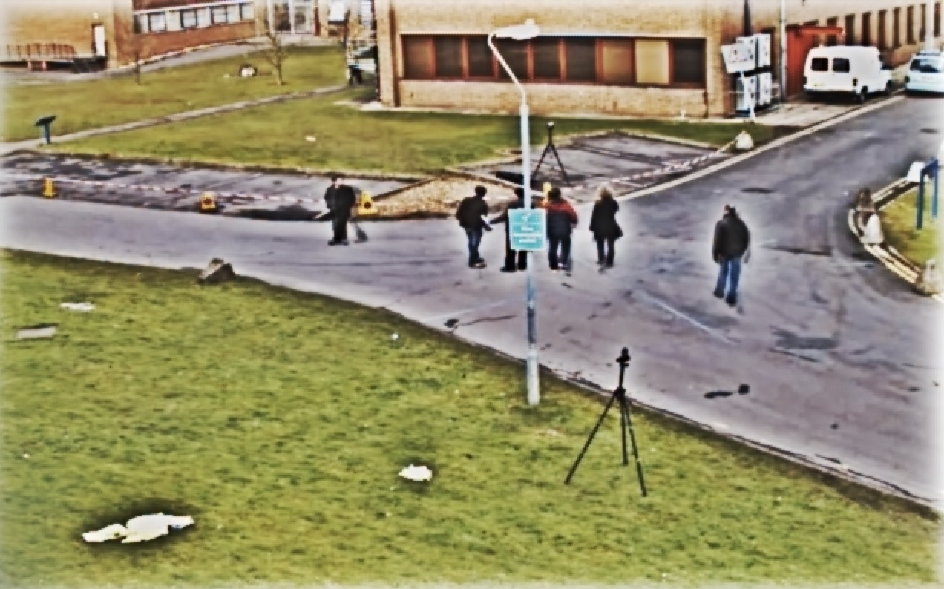
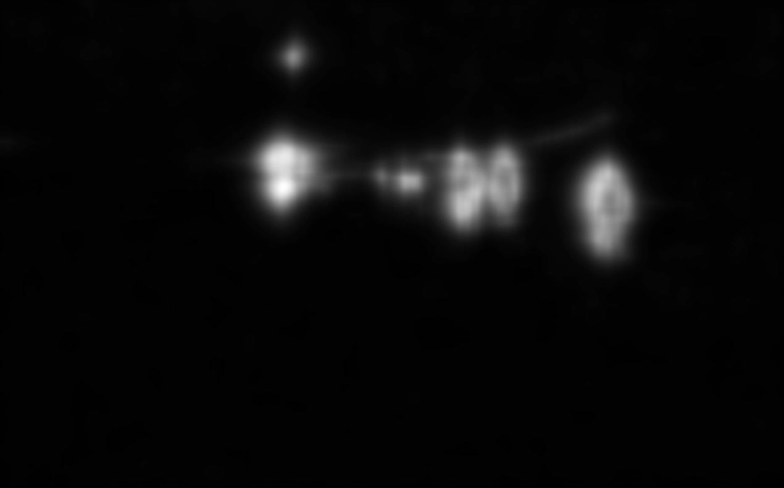
9b. bioinspired
#include “opencv2/bioinspired.hpp”
VideoCapture cap(…);
Ptr<bioinspired::Retina> retina;
Mat frame, parvo, magno;
for(;;) {
cap >> frame;
if(!retina)
retina = bioinspired::createRetina(
frame.size());
retina->run(frame);
retina->getParvo(parvo);
retina->getMagno(magno);
}
Input video
Parvo
Magno

Slide 15
Credits
Min/max problem solvers – Alex Leontiev, GSoC
Connected components – Jason Newton, contribution
HDR – Fedor Morozov, Alexander Shishkov, GSoC
Shape matchers – Juan Manuel Perez, Ilya Lysenkov, GSoC
RHO homography - Bilaniuk, Olexa, Hamid Bazargani, and Robert Laganiere. Contribution
KAZE/AKAZE - Pablo F. Alcantarilla, Eugene Khvedchenya, Fedor Morozov, contribution, GSoC
Viz, Affine3D – Anatoly Baksheev, Ozan Tonkal, GSoC, contribution
Text detection – Lluis Gomez, GSoC’s.
Bioinspired – Alexandre Benoit, contribution & maintainance
Thanks to Google for GSoC’s
Thanks to Magic Leap for the core team funding!

Slide 16
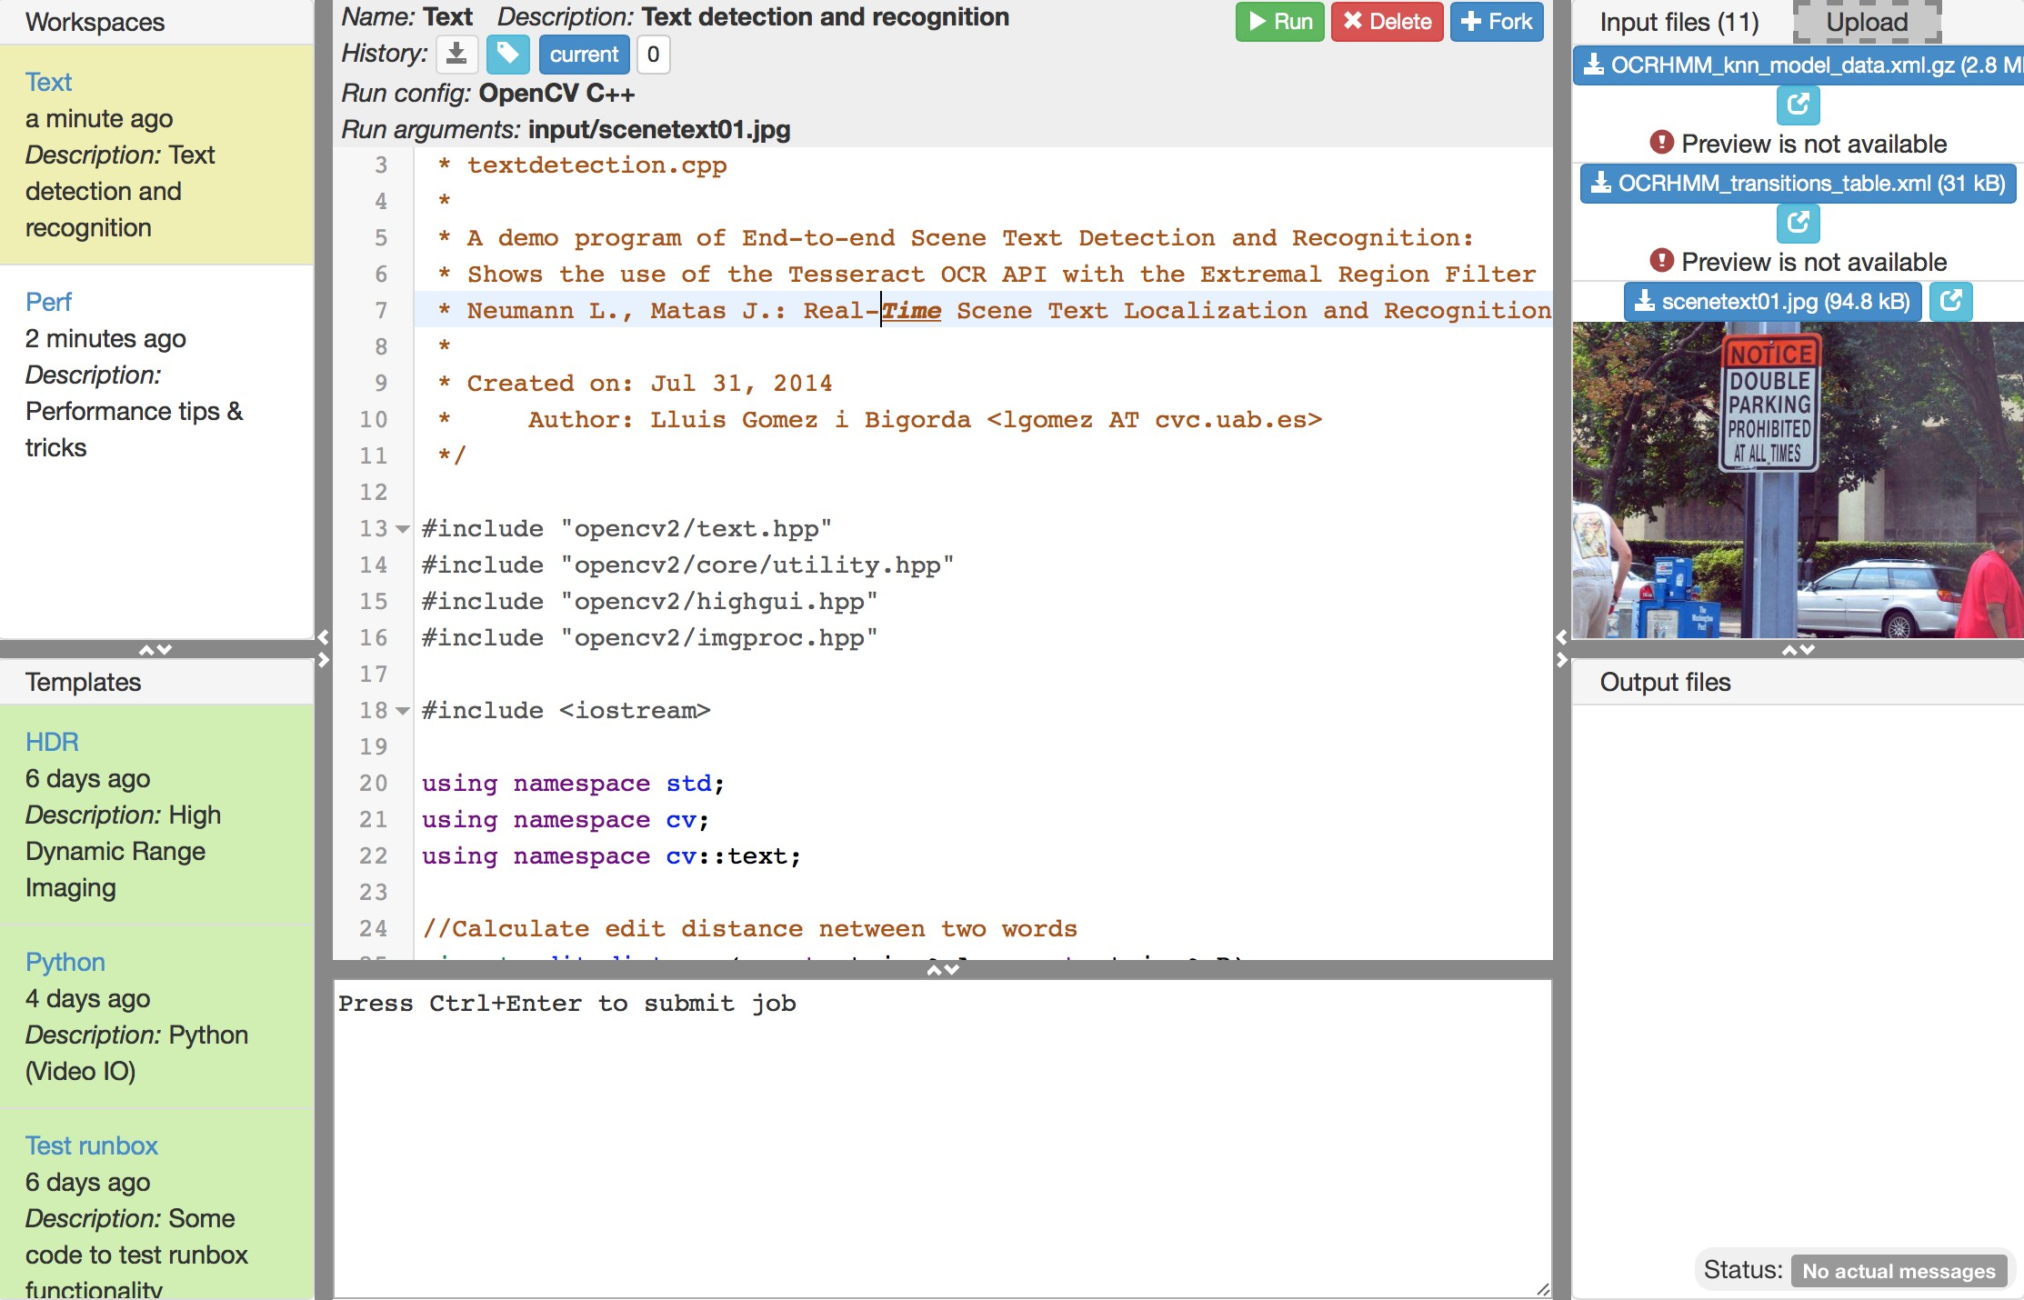
Let’s try it out: web-OpenCV!

